Slide 1
Pumpkin Patch
Presented by: Corbin Zabinski

Slide 2
Agenda
01
02
03
Storyline & Background
Excel Simulation
Outputs & Takeaways

Slide 3
01 Storyline & Background

Slide 4
Market Introduction
Explore pumpkin patches
Experience the harvest with many events and activities
Hay bale rides
Corn mazes
Carnival games
Pumpkin picking
Pumpkin-themed foods and ingredients
Pumpkin pie
Pumpkin spice-flavored drinks and desserts
Notes:
To appreciate autumn’s bounty, we’re always on the hunt for immersive experiences in the heart of nature, with pumpkin patches offering a unique, hands-on journey from farm to table. Pumpkin patches are a wonderful place that offers visitors the opportunity to meet the farmers, explore the farms at their own pace, and gain firsthand knowledge of the cultivation, harvesting, and variety of pumpkins available. Pumpkin Patches offers its guests many activities and events including tractor hay bale rides, corn mazes, carnival games, and pumpkin picking. Furthermore, there are also many pumpkin-themed foods and ingredients such as pumpkin pie, pumpkin bread, pumpkin muffins, and pumpkin spice-flavored drinks and desserts.

Slide 5
Storyline
Located in Southern California between September and October
Produces 8500 lbs of pumpkins per acre
Employees harvest pumpkins and maintain pumpkin patches
Selling pumpkins wholesale and retail.
Sell pumpkins by lbs and to food processing factory
Pumpkin patch events and activities
Leftovers sold as fertilizer
Notes:
Our Pumpkin patch is located in Southern California and occurs during autumn every year between September and October. Our sourced pumpkin patch produces 8500 pounds of pumpkins a year per acre. We have employees who are hired to harvest the pumpkins every day and move them to be displayed in the pumpkin patch. Besides our annual pumpkin patch activities, we gain profits by selling pumpkins wholesale and retail. The pumpkin patch is deciding between two methods of generating income. One way is to sell pumpkins charged by the pound and have any left-over pumpkins being sold to a food processing factory. Some pumpkins harvested will spoil due to improper handling and storage and they can be sold to a retailer that makes fertilizer for a reduced price. The other method is that they can charge people a flat fee to enter the pumpkin patch so that they can participate in the activities and hand-pick one pumpkin free of charge. Because of possible tampering any leftovers can only be sold to the fertilizer retailer for a reduced price.

Slide 6
Assumptions & Goal
Leftover pumpkins sold for fertilizer
Zero waste
Selling by lbs to food processing factory
Flat fee entry model
Hand-picked pumpkins follow normal distribution
Range of visitor preferences and capacities
GOAL: Determine the most profitable revenue model for a pumpkin patch business. By comparing the financial outcomes of two potential approaches (charging by the pound for pumpkins vs. charging a flat fee for entry with a free pumpkin included), the simulation aims to identify which strategy yields higher profitability, considering factors such as pumpkin production, pricing, labor costs, spoilage rate, and alternative revenue streams.
Notes:
If there are leftover pumpkins after the season, regardless of the sales model chosen, these can be sold to a local retailer that makes fertilizer, albeit at a reduced price, ensuring no pumpkins are wasted.
If the pumpkin patch chooses to sell pumpkins by the pound, it can sell all of its pumpkins without any leftovers to a food processing factory at a predetermined price per pound.
In the flat fee entry model, the number of pumpkins hand-picked by each visitor will also follow a normal distribution, reflecting a range of visitor preferences and capacities.
GOAL: Determine the most profitable revenue model for a pumpkin patch business. By comparing the financial outcomes of two potential approaches (charging by the pound for pumpkins vs. charging a flat fee for entry with a free pumpkin included), the simulation aims to identify which strategy yields higher profitability, considering factors such as pumpkin production, pricing, labor costs, spoilage rate, and alternative revenue streams.

Slide 7
02 Excel Simulation

Slide 8
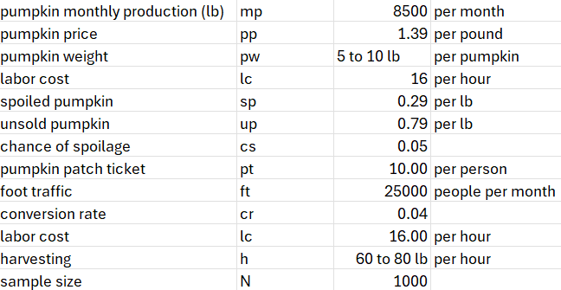
Inputs
Sell by lb
Sell by ticket
Foot traffic is the amount of people that pass by the pumpkin patch
Conversion rate is the amount of foot traffic identified as customers

Slide 9
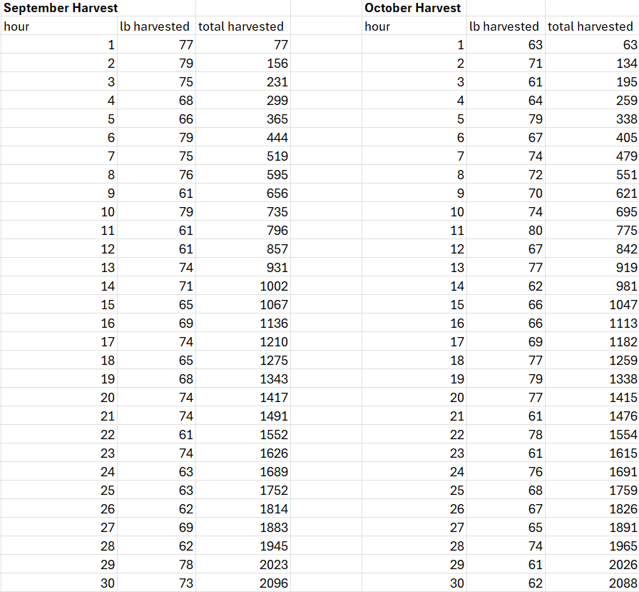
Simulation
Simulation for september and october harvest
Lbs harvested =RANDBETWEEN(60,80)
Total harvest =IF((N3+M4)<mp,N3+M4,0)
N3+M4 (sum of pumpkins harvested)
mp – monthly production
Calculates the total harvest with each growing hour
Total harvest is displayed “0” → when total harvested < mp
=MATCH(0,total_harvested.S,0)
So, in this case, 122 hours are needed to harvest all pumpkins

Slide 10
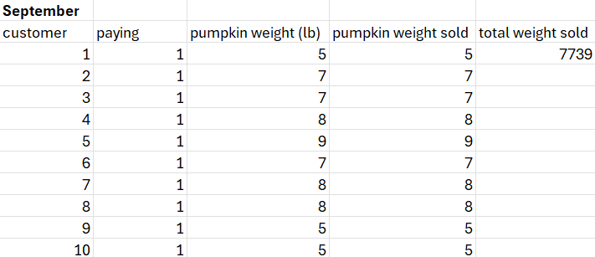
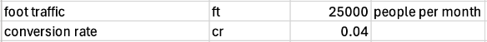
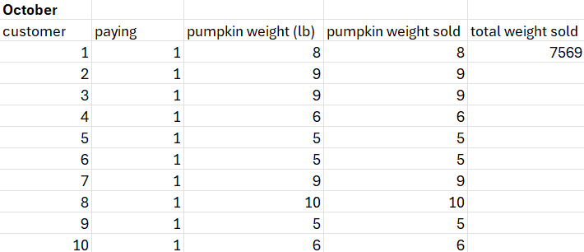
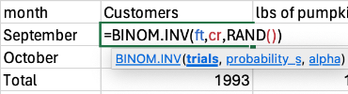
Simulation
Simulation for september and october
Paying =IF(September<T3,0,1)
September = September Customers
T3 (customer 1)
Pumpkin weight =RANDBETWEEN(5,10)
Pumpkin weight sold = pumpkin weight * paying
Total weight sold = sum of Pumpkin weight sold
Notes:
Next part of simulation, total customers, total pumpkin weight sold

Slide 11
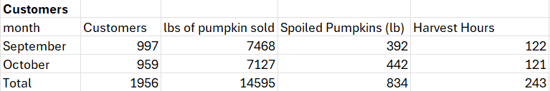
Customer and Harvest Data
Customers (September & October =BINOM.INV(ft,cr,RAND())
Distribution of foot traffic and conversion rate
Lbs of pumpkins sold is the total pumpkin weight sold
Spoiled pumpkins =BINOM.INV(mp,cs,RAND())
Harvest hours =MATCH(0,total_harvested.S,0) & =MATCH(0,total_harvested.O,0)
Total lbs of pumpkins sold =MIN((H3+H4),mp*2-S.p)
H3+H4 (lbs of pumpkins sold between September & October)
Monthly production (mp) * 2- total spoiled pumpkins

Slide 12
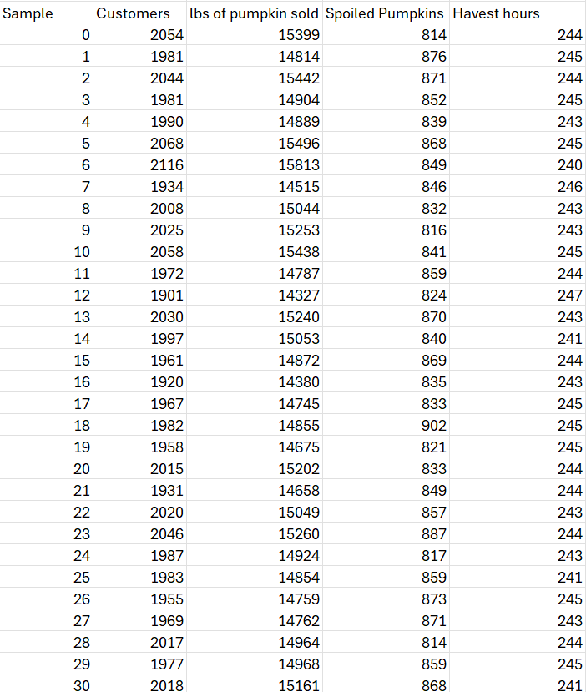
Simulation Cont.
Simulation for 1000 sample
What-if analysis → data table
For customers, lbs of pumpkins sold, spoiled pumpkins, and harvest hours

Slide 13
03 Outputs & Takeaways

Slide 14
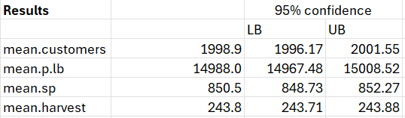
Output/Results
Calculated the mean of customers, pumpkin lbs, spoiled pumpkins, and harvest
Calculated the 95% Confidence Interval for each
For example 95% CI for harvest
=mean.harvest-1.96*(STDEV(harvest.hours.sim)/SQRT(N))
=mean.harvest+1.96*(STDEV(harvest.hours.sim)/SQRT(N))

Slide 15

Output/Results
Pumpkin patch sales (lbs) = (avg pumpkin price*pumpkin pounds)
Pumpkin patch sales (ticket) = (avg customer*pumpkin patch ticket)
Pumpkin pie (lbs) = 0
Pumpkin pie (ticket) = (pumpkin monthly production*2 avg spoiled pumpkins - avg pumpkin lbs)*unsold pumpkins
Fertilizer (lbs) =MAX((mp*2-mean.p.lb)*sp,0)
Fertilizer (ticket) =mean.sp*sp
Cost of labor (lbs) =-mean.harvest*labor cost
Cost of labor (ticket) =-mean.harvest*labor cost
Calculate total profit by summing up profits
Notes:
Separated profit by ticket for the pumpkin patch and by pumpkin sold in lbs. Assessed 4 factors of income for each: pumpkin patch sales, pumpkin pie, fertilizer, and cost of labor

Slide 16
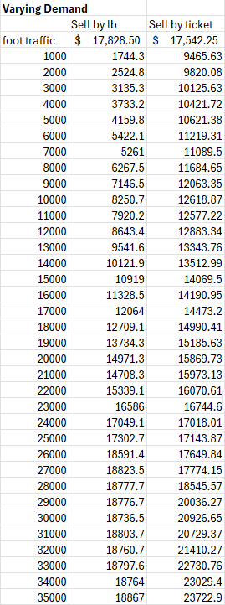
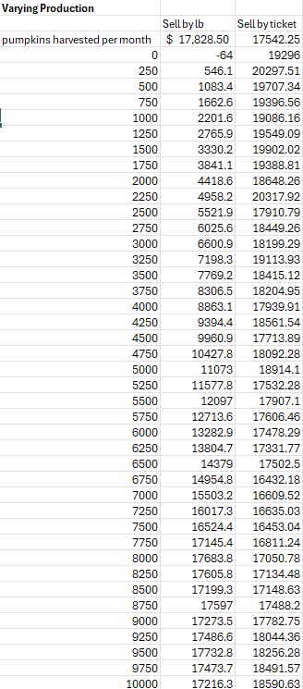
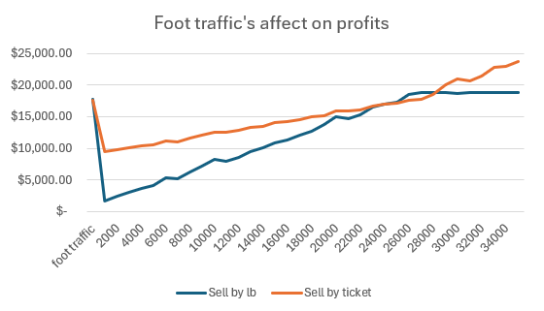
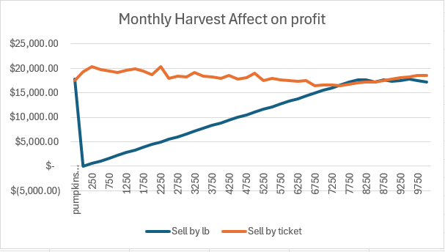
Key Takeaways
Determined how foot traffic affects profits from varying demand
What-if analysis → data table
Input foot traffic = 25000
Determined how monthly harvest affects profits from varying production
What-if analysis → data table
Input pumpkin monthly production = 8500
Notes:
These two graphs represent data from how foot traffic and monthly harvest affects profit.

Slide 17
Thank You!

